Slide 1
Evolutionary programing and genetic algorithms
Evolutionary strategies.
General algorithms

Slide 2
Evolutionary algorithms: family of evolutionary algorithms
General EA algorithms (GA, ES etc.)
  Statement ⇨ decide representation, encoding, decoding, fitness function
  Initialize population (random), evaluate individuals
  While termination conditions not fulfilled, repeat:
    Select parents
    Recombine pairs (n-tuples) of parents, evaluate descendants
    Apply mutations on descendants, evaluate descendants
    Select next generation
  Extract best individual from last generation
  Decode extracted individual ⇨ solution

Slide 3
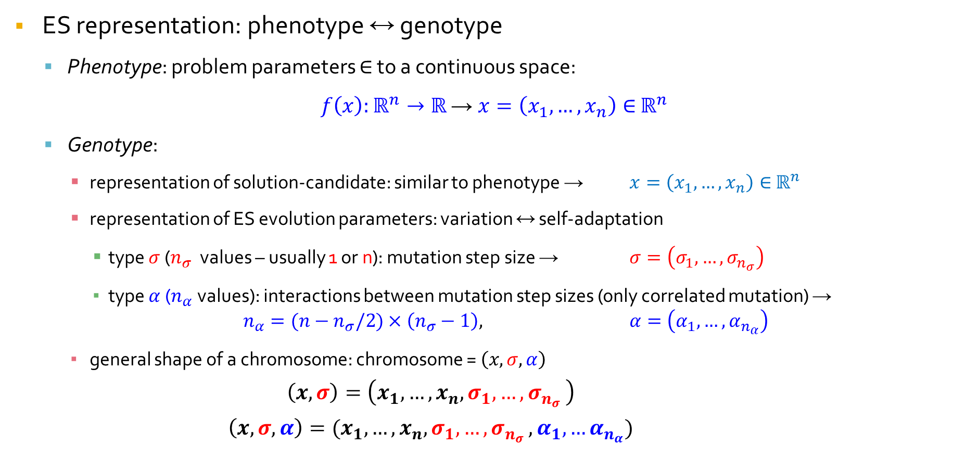
Evolutionary strategies: representation
ES representation: phenotype ↔ genotype
  Phenotype: problem parameters $∈$ to a continuous space:
  $f\left(x\right):ℝ^{n}→ℝ$ → $x=\left(x_{1},…,x_{n}\right)∈$ $ℝ^{n}$
  Genotype:
    representation of solution-candidate: similar to phenotype → $x=\left(x_{1},…,x_{n}\right)∈$ $ℝ^{n}$
    representation of ES evolution parameters: variation ↔ self-adaptation
      type $σ$ ($n_{σ}$ values – usually 1 or n): mutation step size → $σ=\left(σ_{1},…,σ_{n_{σ}}\right)$
      type $α$ ($n_{α}$ values): interactions between mutation step sizes (only correlated mutation) → $n_{α}=(n−n_{σ}/2)×\left(n_{σ}−1\right)\text{,}$ $α=\left(α_{1},…,α_{n_{α}}\right)$
    general shape of a chromosome: chromosome = $\left(x,σ,α\right)$
      $$\left(x,σ\right)=\left(x_{1},…,x_{n},σ_{1},{…,σ}_{n_{σ}}\right)$$
      $$\left(x,σ,α\right)=(x_{1},…,x_{n},σ_{1},{…,σ}_{n_{σ}},α_{1},…α_{n_{α}})$$
GA
ES
Phenotype
Phenotype
Evolution control parameters
Algorithm control parameters
Control parameters
Genotype
Genotype
Solution
Solution part
Parameter part

Slide 4
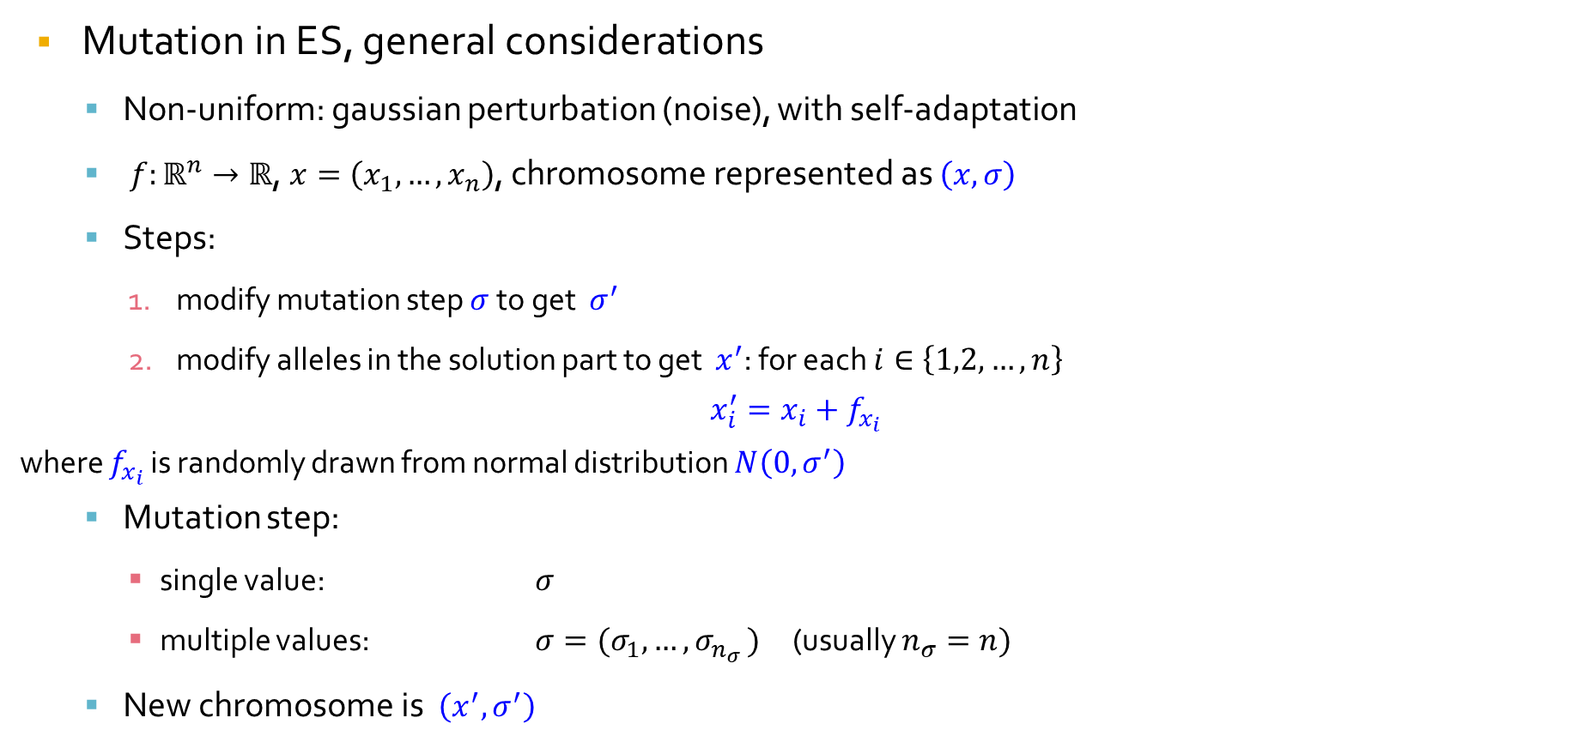
Evolutionary strategies: mutation
Mutation in ES, general considerations
  Non-uniform: gaussian perturbation (noise), with self-adaptation
  $f:ℝ^{n}→ℝ$, $x=\left(x_{1},…,x_{n}\right)$, chromosome represented as $\left(x,σ\right)$
  Steps:
    modify mutation step $σ$ to get $σ^{′}$
    modify alleles in the solution part to get $x^{′}$: for each $i∈\left\{1,2,…,n\right\}$
$$x_{i}^{′}=x_{i}+f_{x_{i}}$$
where $f_{x_{i}}$ is randomly drawn from normal distribution $N\left(0,σ^{′}\right)$
  Mutation step:
    single value: $σ$
    multiple values: ${σ=(σ}_{1},{…,σ}_{n_{σ}})$ (usually $n_{σ}=n)$
  New chromosome is $\left(x^{′},σ^{′}\right)$

Slide 5
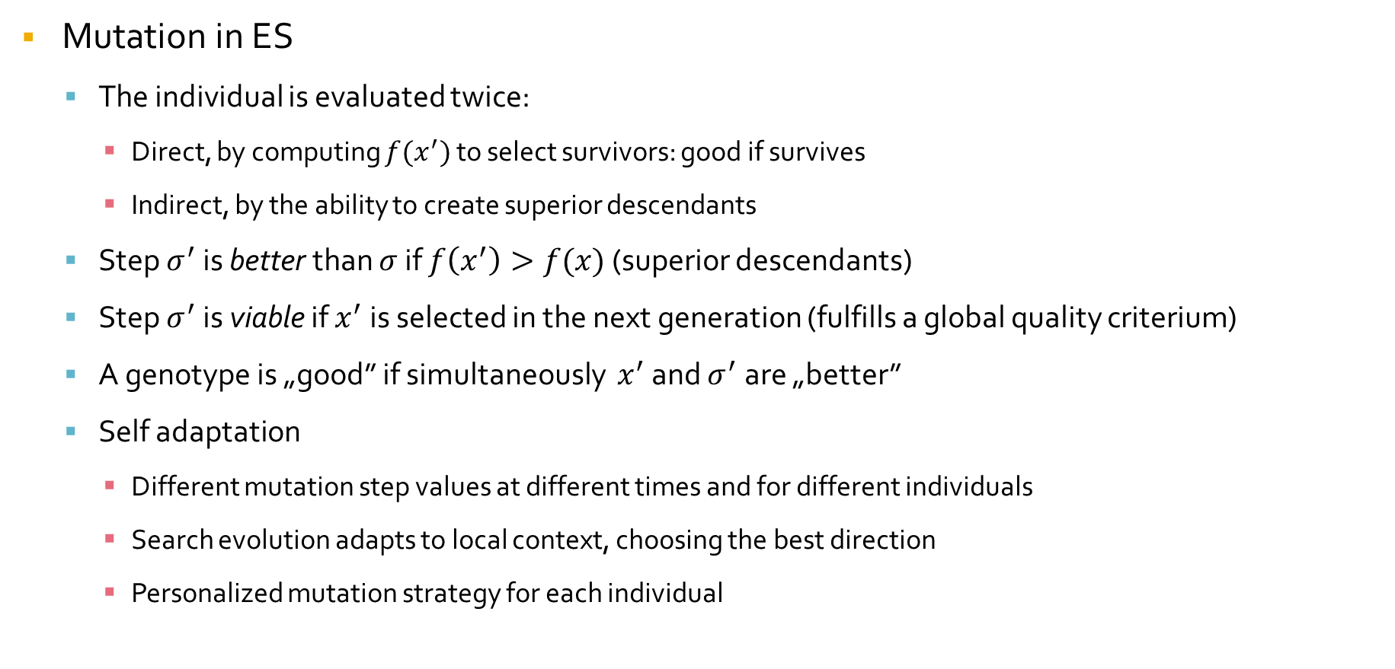
Evolutionary strategies: mutation
Mutation in ES
  The individual is evaluated twice:
    Direct, by computing $f(x^{′})$ to select survivors: good if survives
    Indirect, by the ability to create superior descendants
  Step $σ^{′}$ is better than $σ$ if $f\left(x^{′}\right)>f(x)$ (superior descendants)
  Step $σ^{′}$ is viable if $x^{′}$ is selected in the next generation (fulfills a global quality criterium)
  A genotype is „good” if simultaneously $x^{′}$ and $σ^{′}$ are „better”
  Self adaptation
    Different mutation step values at different times and for different individuals
    Search evolution adapts to local context, choosing the best direction
    Personalized mutation strategy for each individual

Slide 6
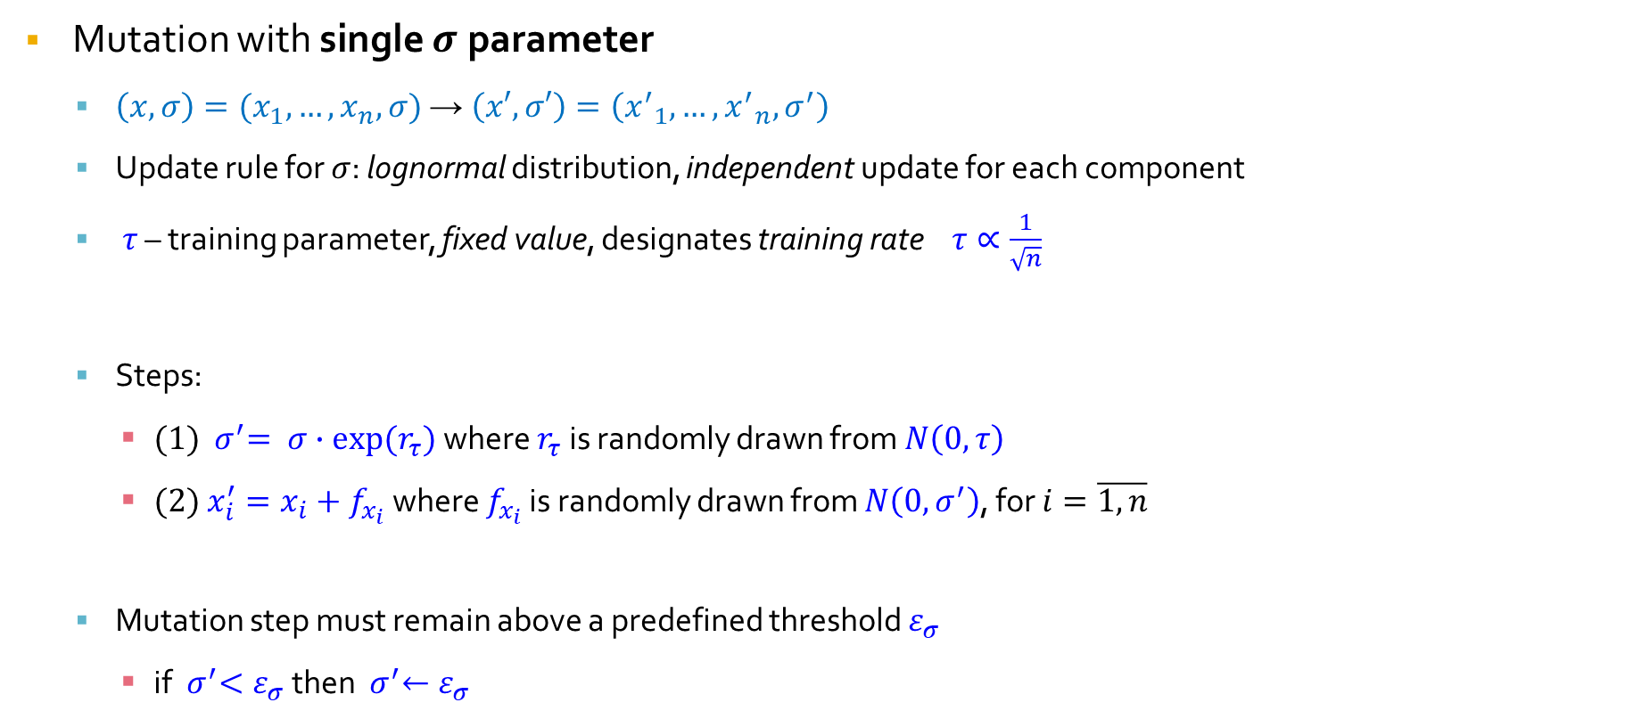
Evolutionary strategies: mutation
Mutation with single $σ$ parameter
  $\left(x,σ\right)=(x_{1},…,x_{n}, σ)$ → $\left(x′,σ′\right)=\left({x^{′}}_{1},…,{x^{′}}_{n}, σ^{′}\right)$
  Update rule for $σ$: lognormal distribution, independent update for each component
  $τ$ – training parameter, fixed value, designates training rate $τ∝\frac{1}{\sqrt{n}}$
  Steps:
    (1) ${ σ}^{′}= σ∙exp⁡(r_{τ})$ where $r_{τ}$ is randomly drawn from $N\left(0,τ\right)$
    (2) $x_{i}^{′}=x_{i}+f_{x_{i}}$ where $f_{x_{i}}$ is randomly drawn from $N\left(0,σ^{′}\right)$, for $i=\overline{1, n}$
  Mutation step must remain above a predefined threshold $ε_{σ}$
    if ${ σ}^{′}<ε_{σ}$ then ${ σ}^{′}←ε_{σ}$

Slide 7
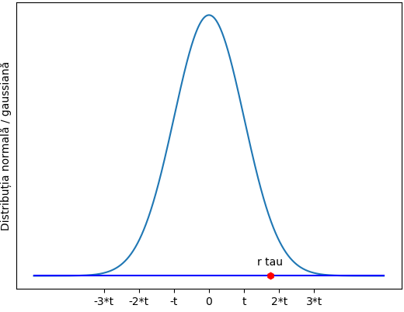
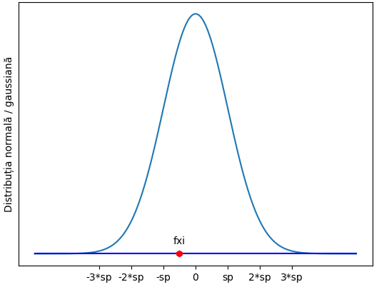



Evolutionary strategies: mutation
$$τ$$
$${ σ}^{′}= σ∙exp⁡(r_{τ})$$
$${ x}_{i}^{′}=x_{i}+f_{x_{i}}$$

Slide 8
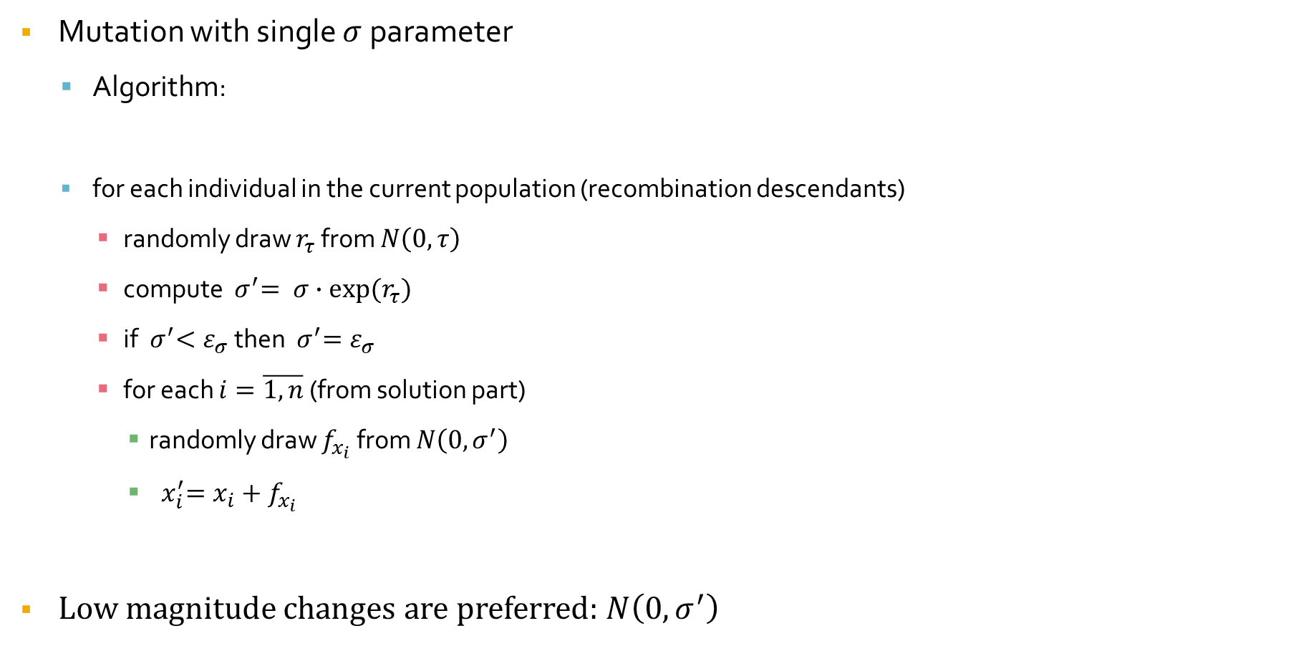
Evolutionary strategies: mutation
Mutation with single $σ$ parameter
  Algorithm:
  for each individual in the current population (recombination descendants)
    randomly draw $r_{τ}$ from $N\left(0,τ\right)$
    compute ${ σ}^{′}= σ∙exp⁡(r_{τ})$
    if ${ σ}^{′}<ε_{σ}$ then ${ σ}^{′}=ε_{σ}$
    for each $i=\overline{1, n}$ (from solution part)
      randomly draw $f_{x_{i}}$ from $N\left(0,σ^{′}\right)$
      ${ x}_{i}^{′}=x_{i}+f_{x_{i}}$
Low magnitude changes are preferred: $N\left(0,σ^{′}\right)$

Slide 9
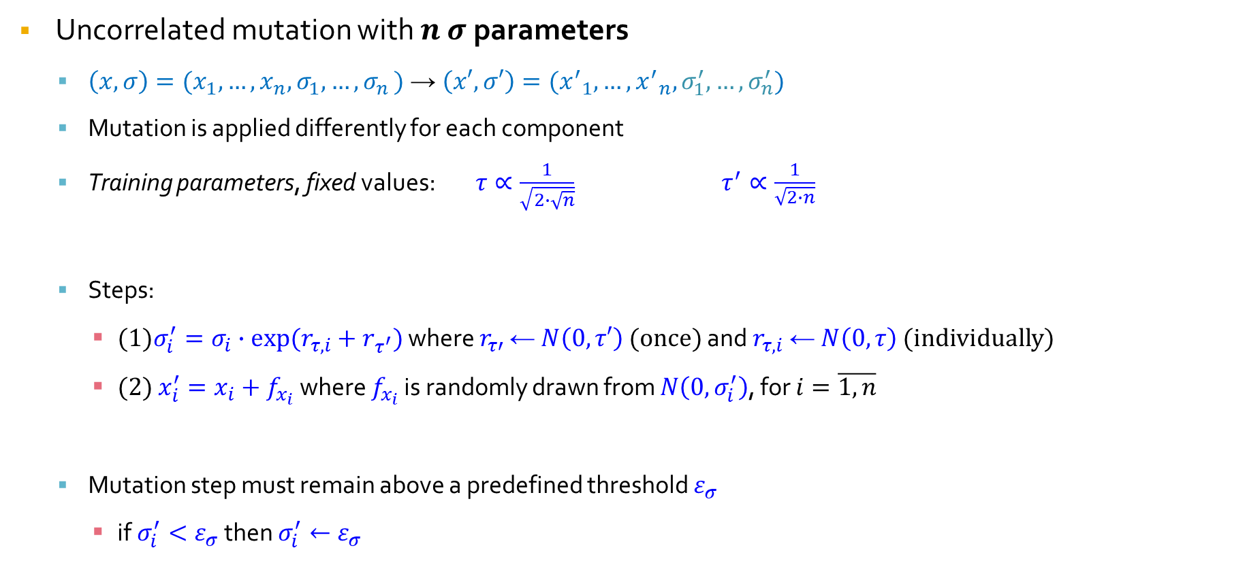
Evolutionary strategies: mutation
Uncorrelated mutation with $n$ $σ$ parameters
  $\left(x,σ\right)=(x_{1},…,x_{n},σ_{1},{…,σ}_{n})$ → $\left(x′,σ′\right)=({x^{′}}_{1},…,{x^{′}}_{n},σ_{1}^{′},…,σ_{n}^{′})$
  Mutation is applied differently for each component
  Training parameters, fixed values: $τ∝\frac{1}{\sqrt{2∙\sqrt{n}}}$ $τ^{′}∝\frac{1}{\sqrt{2∙n}}$
  Steps:
    (1)$σ_{i}^{′}=σ_{i}∙exp⁡(r_{τ,i}+r_{τ^{′}})$ where $r_{τ′}$ ← $N\left(0,τ′\right)$ (once) and $r_{τ,i}$ ← $N\left(0,τ\right)$ (individually)
    (2) $x_{i}^{′}=x_{i}+f_{x_{i}}$ where $f_{x_{i}}$ is randomly drawn from $N\left(0,σ_{i}^{′}\right)$, for $i=\overline{1, n}$
  Mutation step must remain above a predefined threshold $ε_{σ}$
    if$σ_{i}^{′}<ε_{σ}$ then $σ_{i}^{′}←ε_{σ}$

Slide 10
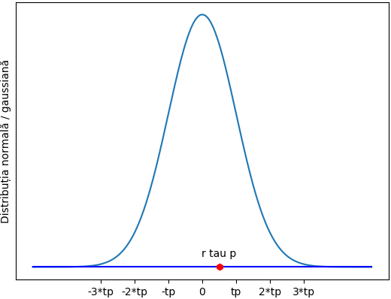




Evolutionary strategies: mutation
$$τ$$
$$τ^{′}$$
$$σ_{i}^{′}=σ_{i}∙exp⁡(r_{τ,i}+r_{τ^{′}})$$
$${ x}_{i}^{′}=x_{i}+f_{x_{i}}$$

Slide 11
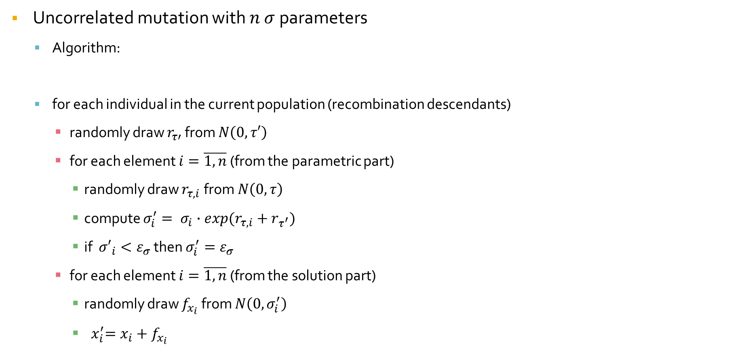
Evolutionary strategies: mutation
Uncorrelated mutation with $n$ $σ$ parameters
  Algorithm:
  for each individual in the current population (recombination descendants)
    randomly draw $r_{τ′}$ from $N\left(0,τ′\right)$
    for each element $i=\overline{1, n}$ (from the parametric part)
      randomly draw $r_{τ,i}$ from $N\left(0,τ\right)$
      compute $σ_{i}^{′}= σ_{i}∙exp⁡(r_{τ,i}+r_{τ^{′}})$
      if ${σ′}_{i}<ε_{σ}$ then $σ_{i}^{′}=ε_{σ}$
    for each element $i=\overline{1, n}$ (from the solution part)
      randomly draw $f_{x_{i}}$ from $N\left(0,σ_{i}^{′}\right)$
      ${ x}_{i}^{′}=x_{i}+f_{x_{i}}$

Slide 12
Evolutionary strategies: parents selection
Parents selection in ES
Chromosome fitness is not important for ES parents selection
The entire current population is considered the mating pool (no selection)
For recombination the parents are randomly chosen (uniform distribution) from the current population

Slide 13
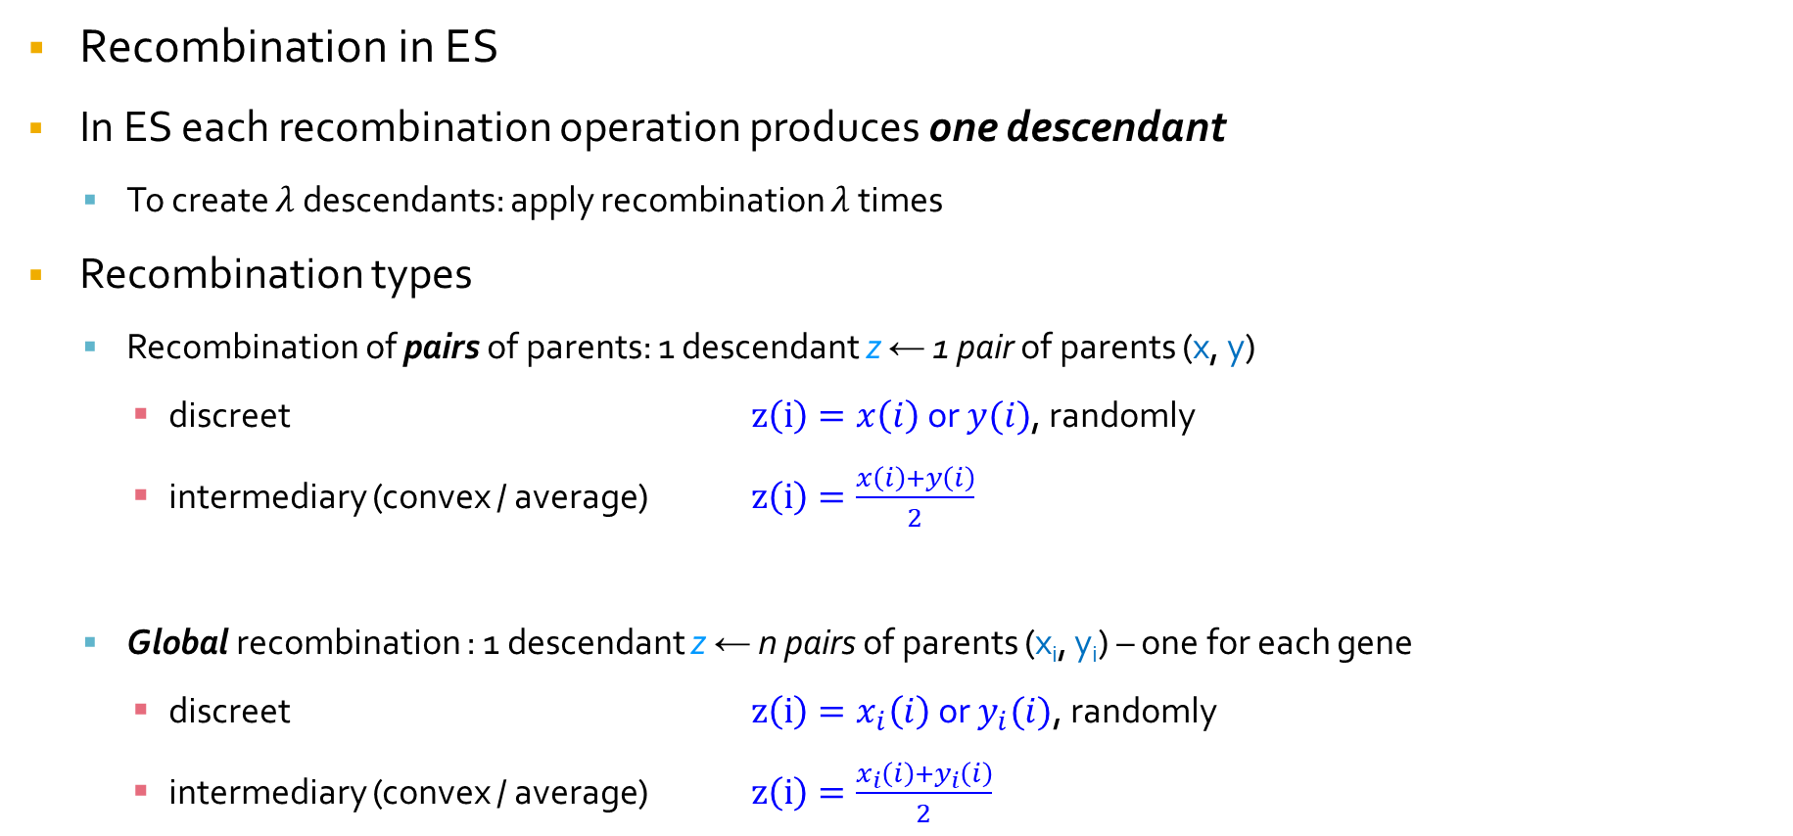
Evolutionary strategies: recombination
Recombination in ES
In ES each recombination operation produces one descendant
  To create $λ$ descendants: apply recombination $λ$ times
Recombination types
  Recombination of pairs of parents: 1 descendant z ← 1 pair of parents (x, y)
    discreet $z\left(i\right)=x\left(i\right)$ or $y(i)$, randomly
    intermediary (convex / average) $z\left(i\right)=\frac{x\left(i\right)+y\left(i\right)}{2}$
  Global recombination : 1 descendant z ← n pairs of parents (x_{i}, y_{i}) – one for each gene
    discreet $z\left(i\right)=x_{i}\left(i\right)$ or $y_{i}(i)$, randomly
    intermediary (convex / average) $z\left(i\right)=\frac{x_{i}\left(i\right)+y_{i}\left(i\right)}{2}$

Slide 14
Evolutionary strategies: recombination of pairs of parents
x
descendant
y

Slide 15
Evolutionary strategies: global recombination
x3
x2
xn
x1
...
descendant
...
yn
y1
y2
y3

Slide 16
Evolutionary strategies: recombination
Notes
  Usual recombination: global
    Discreet for solution part: maintains genetic diversity
    Intermediary for parameter part: cautious adaptation strategy
  Number of descendants is (much) larger than the population size
    Contributes the maintaining the self-adaptation feature
    Reduced selection pressure, avoids getting stuck in local optima

Slide 17
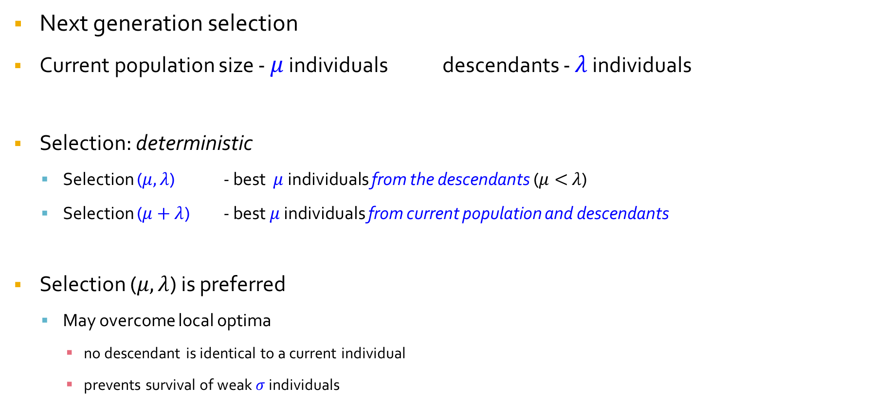
Evolutionary strategies: next generation selection
Next generation selection
Current population size - $μ$ individuals descendants - $λ$ individuals
Selection: deterministic
  Selection ($μ,λ$) - best $μ$ individuals from the descendants ($μ<$ $λ$)
  Selection ($μ+λ$) - best $μ$ individuals from current population and descendants
Selection ($μ,λ$) is preferred
  May overcome local optima
    no descendant is identical to a current individual
    prevents survival of weak $σ$ individuals

Slide 18
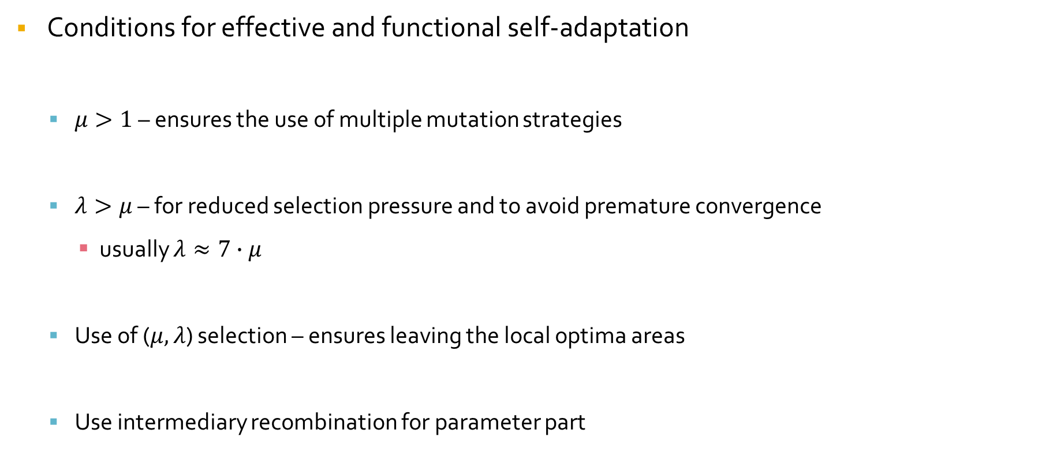
Evolutionary strategies
Conditions for effective and functional self-adaptation
  $μ>1$ – ensures the use of multiple mutation strategies
  $λ>μ$ – for reduced selection pressure and to avoid premature convergence
    usually $λ≈7∙μ$
  Use of ($μ,λ$) selection – ensures leaving the local optima areas
  Use intermediary recombination for parameter part

Slide 19
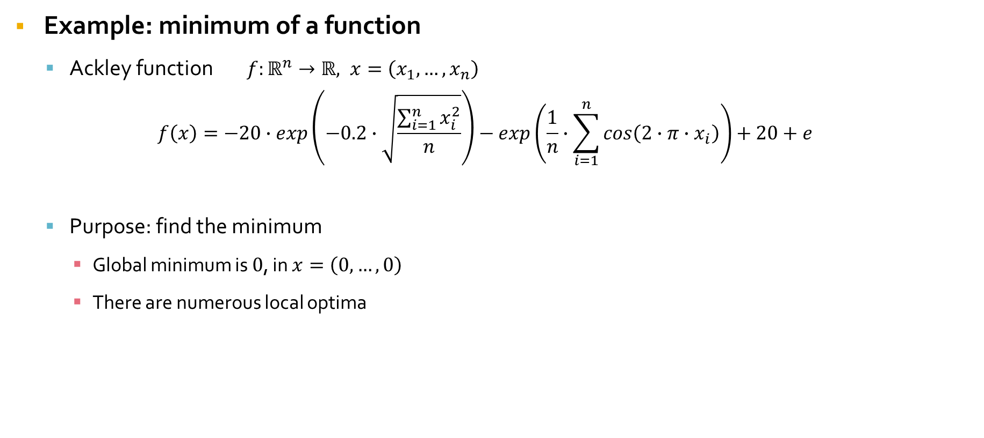
Evolutionary strategies: example – Ackley function
Example: minimum of a function
  Ackley function $f:ℝ^{n}→ℝ, x=\left(x_{1},…,x_{n}\right)$
$$f\left(x\right)=−20∙exp\left(−0.2∙\sqrt{\frac{\sum_{i=1}^{n}{x_{i}^{2}}}{n}}\right)−exp\left(\frac{1}{n}∙\sum_{i=1}^{n}{cos\left(2∙π∙x_{i}\right)}\right)+20+e$$
  Purpose: find the minimum
    Global minimum is $0$, in $x=\left(0,…,0\right)$
    There are numerous local optima

Slide 20
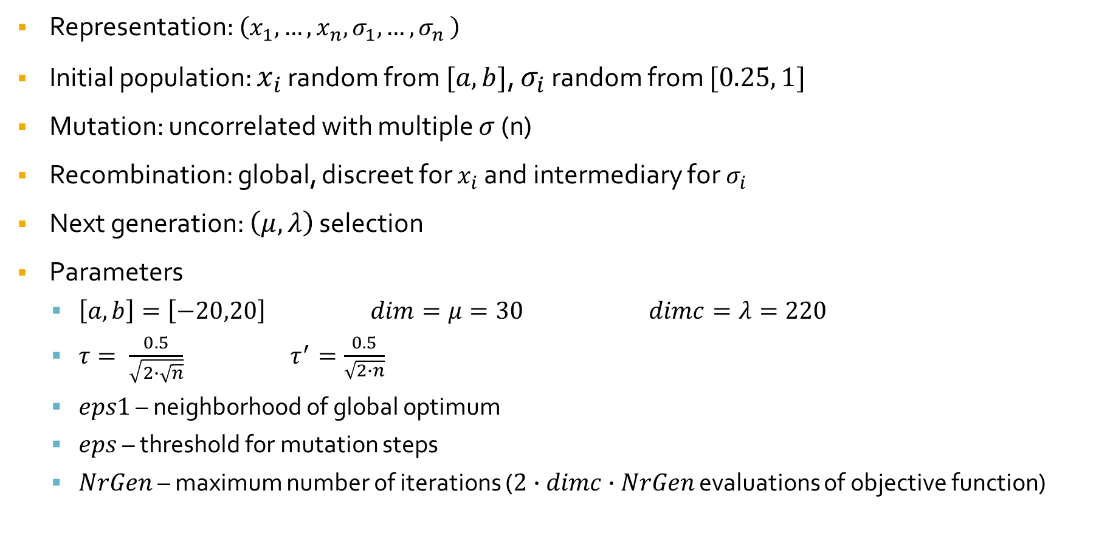
Evolutionary strategies: example – Ackley function
Representation: $\left(x_{1},…,x_{n},σ_{1},{…,σ}_{n}\right)$
Initial population: $x_{i}$ random from $[a,b]$, $σ_{i}$ random from $[0.25, 1]$
Mutation: uncorrelated with multiple $σ$ (n)
Recombination: global, discreet for $x_{i}$ and intermediary for $σ_{i}$
Next generation: $\left(μ,λ\right)$ selection
Parameters
  $\left[a,b\right]=\left[−20,20\right]$ $dim=μ=30$ $dimc=λ=220$
  $τ= \frac{0.5}{\sqrt{2∙\sqrt{n}}}$ $τ^{′}=\frac{0.5}{\sqrt{2∙n}}$
  $eps1$ – neighborhood of global optimum
  $eps$ – threshold for mutation steps
  $NrGen$ – maximum number of iterations ($2∙dimc∙NrGen$ evaluations of objective function)

Slide 21
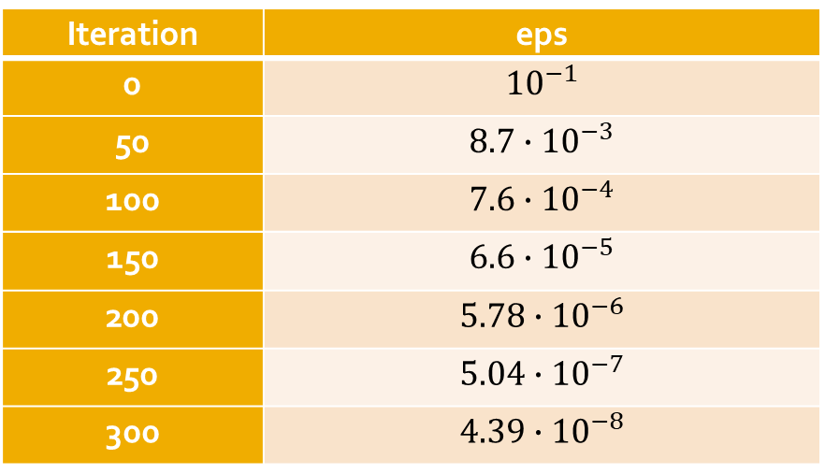
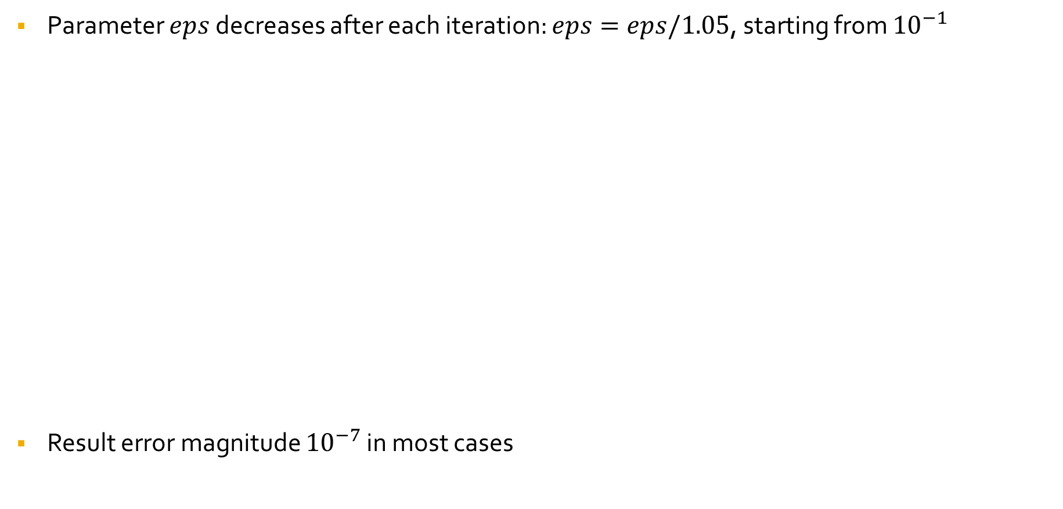
Evolutionary strategies: example – Ackley function
Parameter $eps$ decreases after each iteration: $eps=eps/1.05$, starting from ${10}^{−1}$
Result error magnitude ${10}^{−7}$ in most cases
Iteration | eps
0 | $${10}^{−1}$$
50 | $$8.7∙{10}^{−3}$$
100 | $$7.6∙{10}^{−4}$$
150 | $$6.6∙{10}^{−5}$$
200 | $$5.78∙{10}^{−6}$$
250 | $$5.04∙{10}^{−7}$$
300 | $$4.39∙{10}^{−8}$$

Slide 22
Evolutionary strategies: example – Ackley function
n=20 # number of axes
tau=0.5/sqrt(2*sqrt(n))
taup=0.5/sqrt(2*n)
NrGen=300 # number of iterations
a=-20; b=20 # definition interval for each axis
DimPop=30 # population size
DimDesc=220 # number of descendants for each iteration
eps=1e-1 # initial threshold for mutation step
# eps1=1e-7
eps1=1e-20 # neighborhood of global optimum
sol,val = ES.ES_Ackley(n,a,b,DimPop,DimDesc,NrGen,tau,taup,eps,eps1)

Slide 23
Spor la învăţat!

